Slide 1

Unit-III Classification
B. Ujwala
Asst. Professor
Dept of CSE, AU

Slide 2
Topics to Be Covered
What is Classification?
General approach to Classification
K-Nearest Neighbor Algorithm
Logistic regression
Decision Trees
Naive Bayesian
Support Vector Machine (SVM)

Slide 3
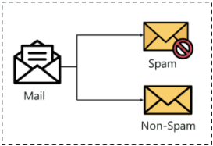
What is Classification?
Classification is a supervised machine learning method where the model tries to predict the correct label of a given input data.
In classification, the model is fully trained using the training data, and then it is evaluated on test data before being used to perform prediction on unseen data.
For Example, an algorithm can learn to predict whether
→a given email is spam or ham (no spam)
→a tumor is malignant or benign’

Slide 4
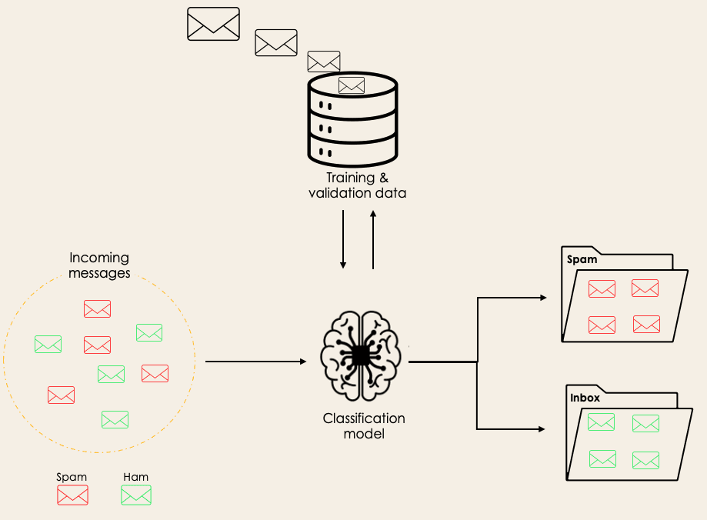
Classification model
→A target feature is categorical type
→The target categorical feature is known as class .

Slide 5
Classification Terminologies In ML
Classifier – It is an algorithm that is used to map the input data to a specific category.
Classification Model – The model predicts or draws a conclusion to the input data given for training, it will predict the class or category for the data.
Feature – A feature is an individual measurable property of the phenomenon being observed.
Binary Classification – It is a type of classification with two outcomes, for eg – either True or False / 1 or 0 / Yes or No
Multi-Class Classification – The classification with more than two classes, in multi-class classification each sample is assigned to one and only one label or target.
Multi-label Classification – This is a type of classification where each sample is assigned to a set of labels or targets.

Slide 6
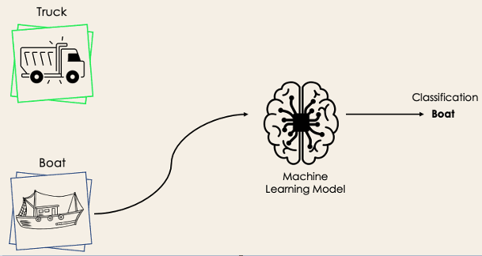
Binary Classification

Slide 7
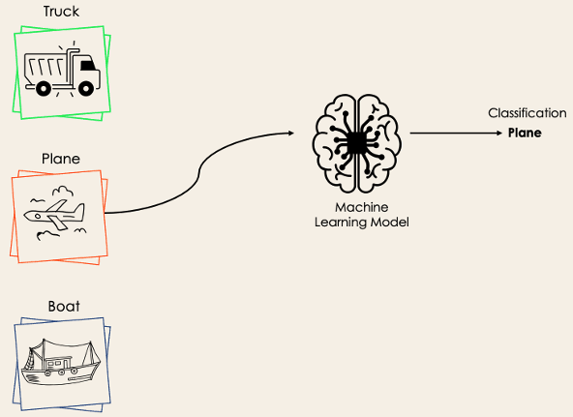
Multi-Class Classification

Slide 8
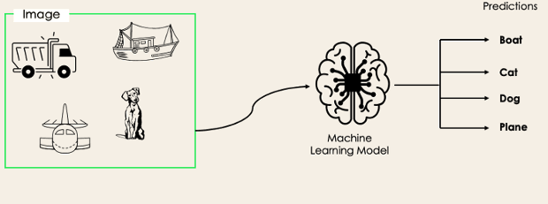
Multi-label Classification

Slide 9
Classification Usecases
Image classification
Disease prediction
Win–loss prediction of games
Prediction of natural calamity such as earthquake, flood, etc.
Handwriting recognition
Document Classification
Spam Filters

Slide 10
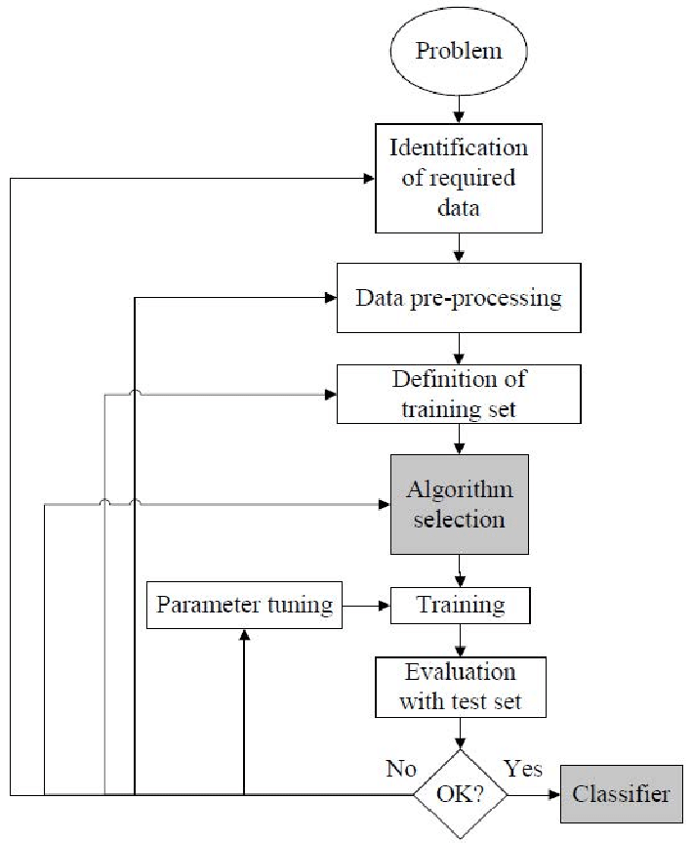
Classification Model Steps in ML
Problem Identification
Identification of Required Data
Data Pre-processing
Definition of Training Data Set
Algorithm Selection
Training
Evaluation with the Test Data Set

Slide 11
Algorithms for Classification
k nearest neighbour
Logistic regression
Decision tree
support vector machine
Naive bayes
Random forest

Slide 12
K-Nearest Neighbor (KNN) Algorithm
K-Nearest Neighbors is one of the simplest supervised machine learning algorithms used for classification. It classifies a data point based on its neighbors’ classifications. It stores all available cases and classifies new cases based on similar features.
It is a lazy learning algorithm that stores all instances corresponding to training data in n-dimensional space
Classification is computed from a simple majority vote of the k nearest neighbors of each point.
To label a new point, it looks at the labeled points closest to that new point also known as its nearest neighbors. It has those neighbors vote, so whichever label most of the neighbors have is the label for the new point. The “k” is the number of neighbors it checks.

Slide 13
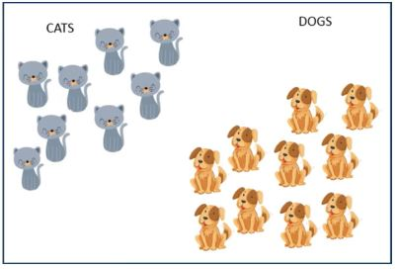
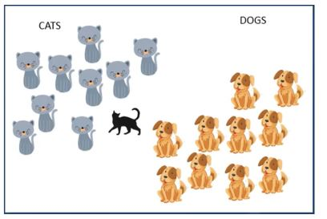
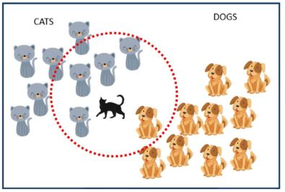
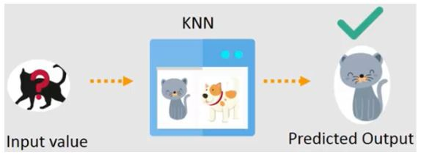
KNN

Slide 14
K-Nearest Neighbor (KNN) Algorithm
These distance functions can be Euclidean, Manhattan, Minkowski and Hamming distance
How to Choose the Factor ‘K’?
A KNN algorithm is based on feature similarity. Selecting the right K value is a process called parameter tuning, which is important to achieve higher accuracy.
Sqrt(n), where n is the total number of data points
Odd value of ‘k’ is selected to avoid confusion
We can use KNN when data is labeled, noise free and dataset is small

Slide 15
kNN algorithm
Input: Training data set, test data set (or data points), value of ‘k’ (i.e. number of nearest neighbours to be considered)
Steps:
Step-1: Calculate Similarity based on distance function
Step-2: Choose the K value
Step-2: Find K-Nearest Neighbors and rank them based on minimal distance
Step-3: Among these k neighbors, count the number of the data points in each category.
Step-5: Assign the new data points to the category for which the number of the neighbor is maximum.

Slide 16
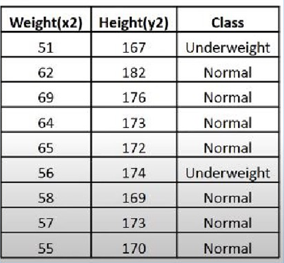
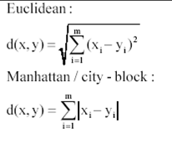
How Does KNN work?
Consider a dataset with two variables height(cms), weight(kg) and each data point is classified as Normal and Underweight

Slide 17
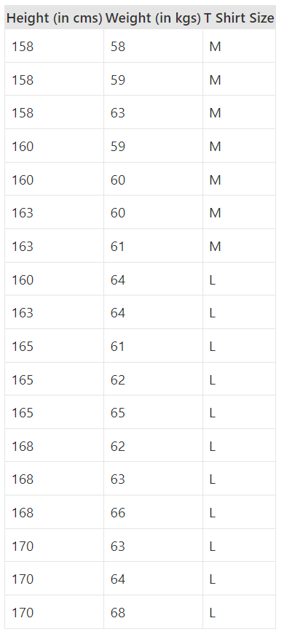
How Does KNN work?
Suppose we have height, weight and T-shirt size of some customers and we need to predict the T-shirt size of a new customer given only height and weight information we have. Data including height, weight and T-shirt size information is shown below
If a customer has height 161cm and weight 61kg then what would be his T-Shirt size?

Slide 18
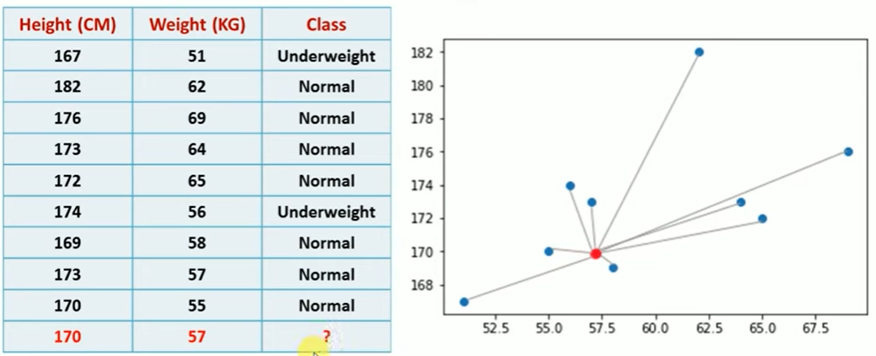
How Does KNN work?
Step 1 : Calculate Similarity based on distance function

Slide 19
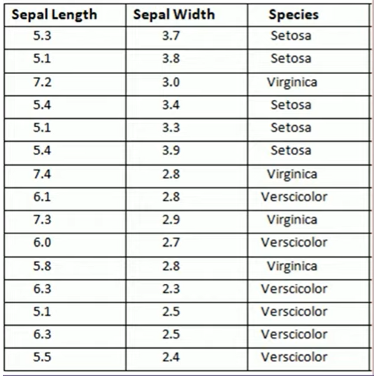
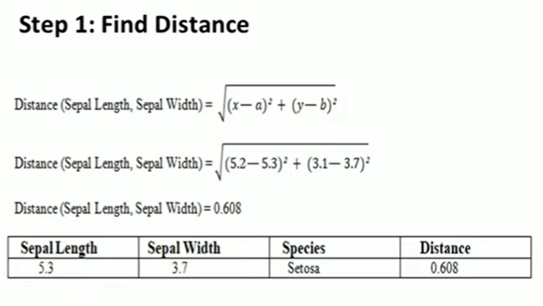
Another Problem

Slide 20
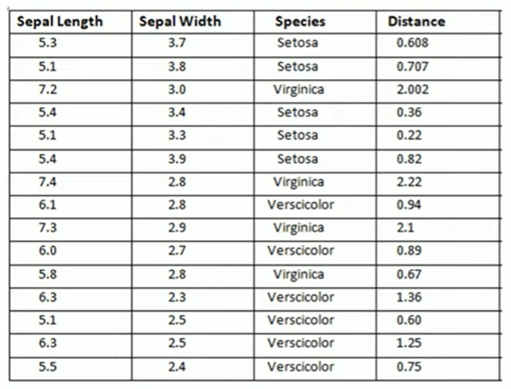

Slide 21
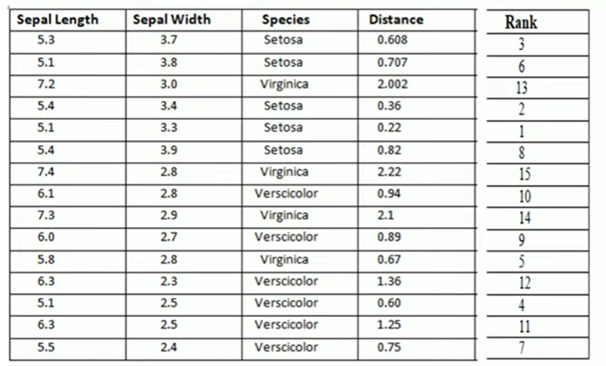

Slide 22
K-Nearest Neighbor (KNN) Algorithm
Applications
Recommender Systems
Document / Content Searching
Advantages
Extremely simple algorithm – easy to understand
Very effective in certain situations, e.g. for recommender system design
Very fast or almost no time required for the training phase
Disadvantages
Does not learn anything
Computation cost is high because of calculating the distance between the data points for all the training samples.

Slide 23
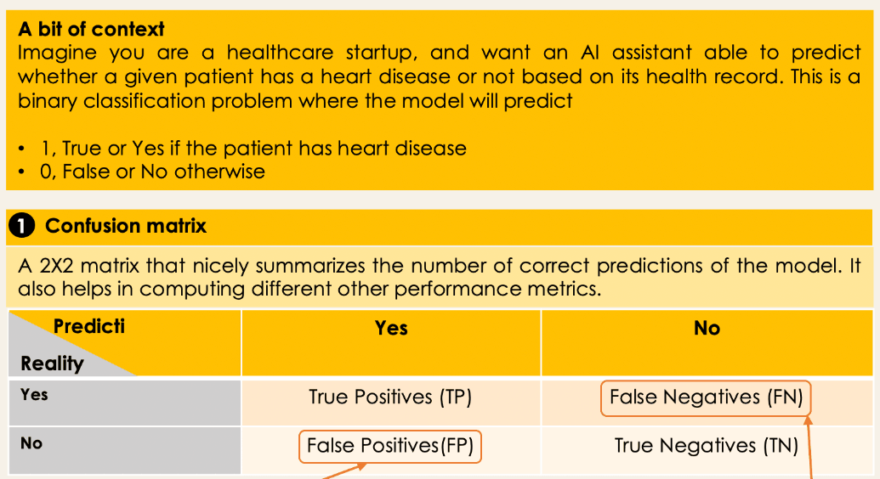
Metrics to Evaluate ML Classification Algorithms

Slide 24
Metrics to Evaluate ML Classification Algorithms
True positives: The number of positive observations the model correctly predicted as positive.
False-positive: The number of negative observations the model incorrectly predicted as positive.
True negative: The number of negative observations the model correctly predicted as negative.
False-negative: The number of positive observations the model incorrectly predicted as negative.

Slide 25
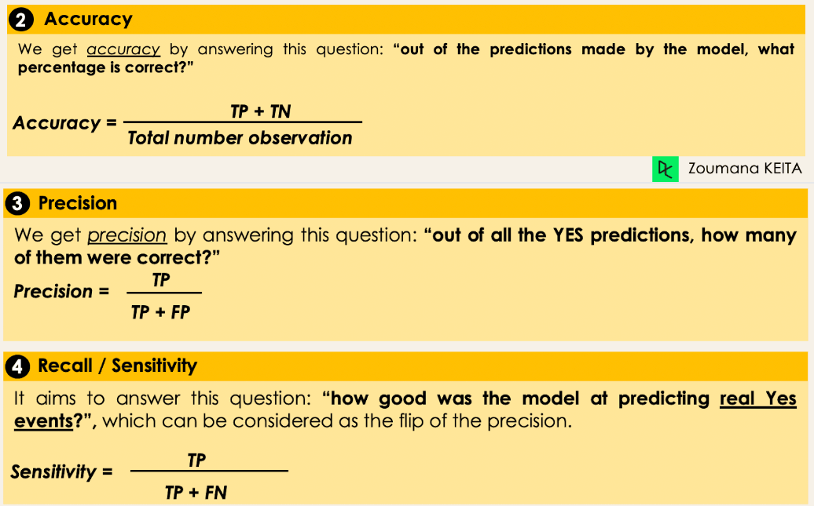
Metrics to Evaluate ML Classification Algorithms

Slide 26
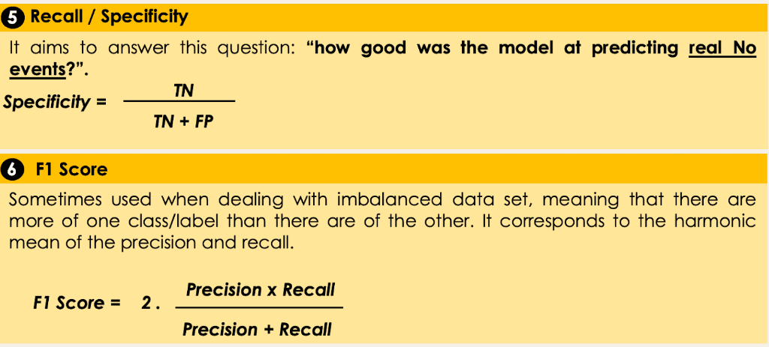
Metrics to Evaluate ML Classification Algorithms

Slide 27
Decision tree
Decision tree learning is one of the most widely adopted algorithms for classification. As the name indicates, it builds a model in the form of a tree structure
A decision tree is used for multi-dimensional analysis with multiple classes.
The goal of decision tree learning is to create a model that predicts the value of the output variable based on the input variables in the feature vector.
Each node (or decision node) of a decision tree corresponds to one of the feature vector. From every node, there are edges to children, wherein there is an edge for each of the possible values (or range of values) of the feature associated with the node.
The tree terminates at different leaf nodes (or terminal nodes) where each leaf node represents a possible value for the output variable
The output variable is determined by following a path that starts at the root and is guided by the values of the input variables.

Slide 28
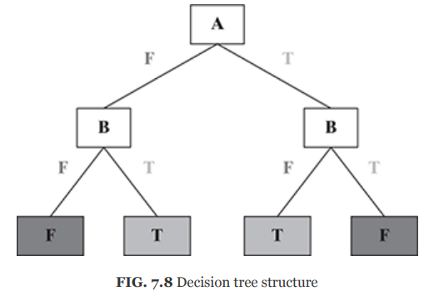
Decision tree
A decision tree is usually represented in the format depicted in Figure 7.8.
Each internal node (represented by boxes) tests an attribute (represented as ‘A’/‘B’ within the boxes). Each branch corresponds to an attribute value (T/F) in the above case. Each leaf node assigns a classification. The first node is called as ‘Root’ Node. Branches from the root node are called as ‘Leaf’ Nodes where ‘A’ is the Root Node (first node). ‘B’ is the Branch Node. ‘T’ & ‘F’ are Leaf Nodes.
A decision tree consists of three types of nodes:
Root Node
Branch Node
Leaf Node

Slide 29
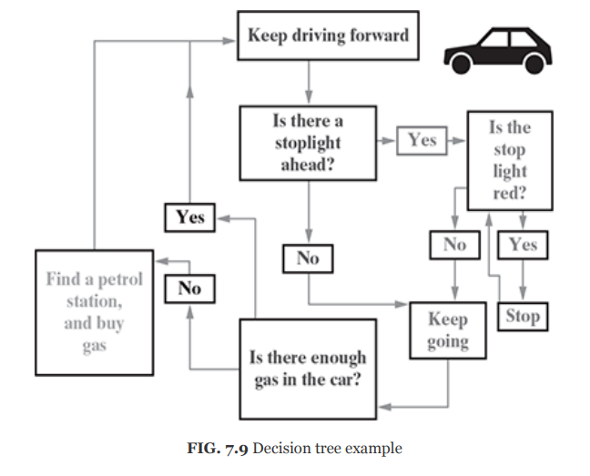
Decision Tree Example

Slide 30
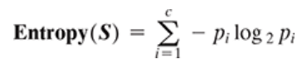
Decision tree
There are many implementations of decision tree, the most prominent ones being C5.0, CART (Classification and Regression Tree), CHAID (Chi-square Automatic Interaction Detector) and ID3 (Iterative Dichotomiser 3) algorithms.
If the partitions created by the split contain examples belonging to a single class, then the partitions are considered to be pure.
Entropy is a measure of impurity of an attribute or feature adopted by many algorithms such as ID3 and C5.0.
Let us say S is the sample set of training examples. Then, Entropy (S) measuring the impurity of S is defined as
where c is the number of different class labels and p refers to the proportion of values falling into the i-th class label.

Slide 31
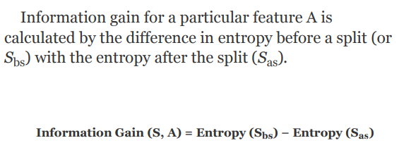
Decision Tree

Slide 32
Decision Tree Algorithm
1. Select the best attribute using Attribute Selection Measures(ASM) to split the records.
2. Make that attribute a decision node and breaks the dataset into smaller subsets.
3. Starts tree building by repeating this process recursively for each child until one of the conditions match:
All the tuples belong to the same attribute value.
There are no more remaining attributes.
There are no more instances.

Slide 33
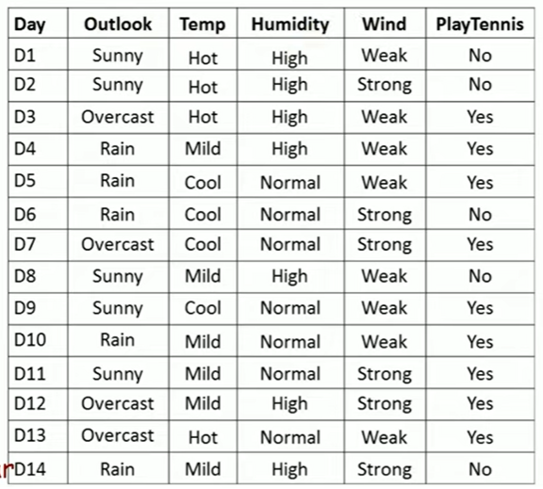

Slide 34
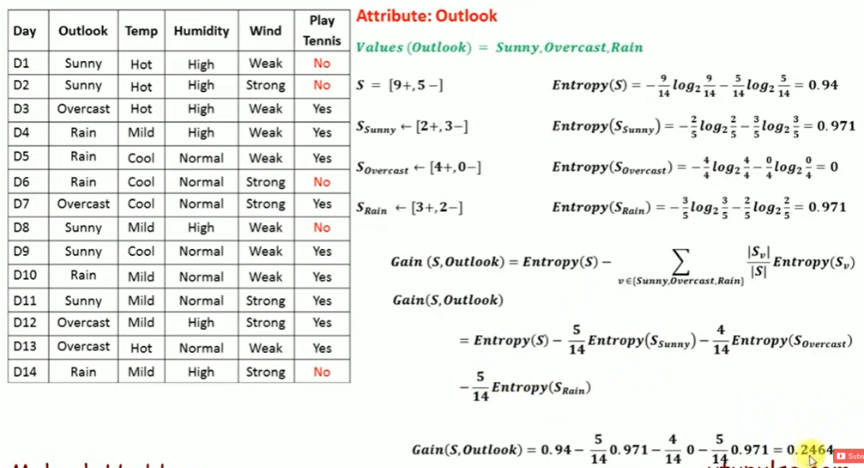

Slide 35
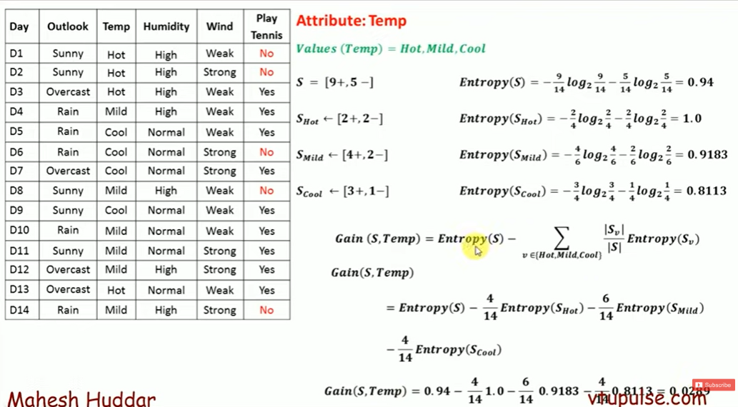

Slide 36
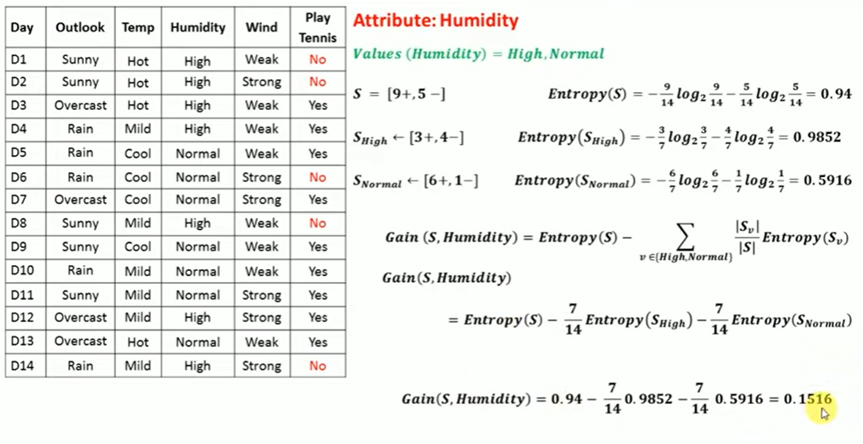

Slide 37
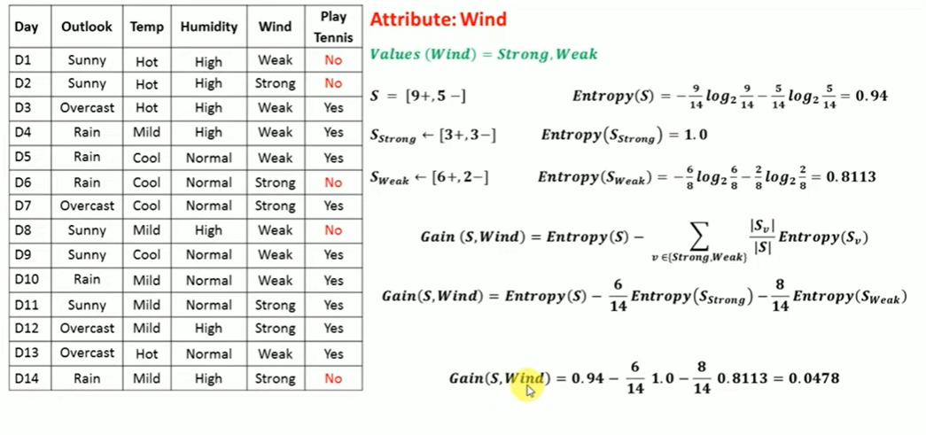

Slide 38
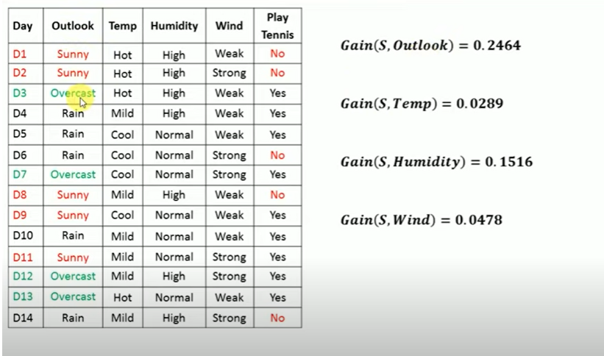

Slide 39
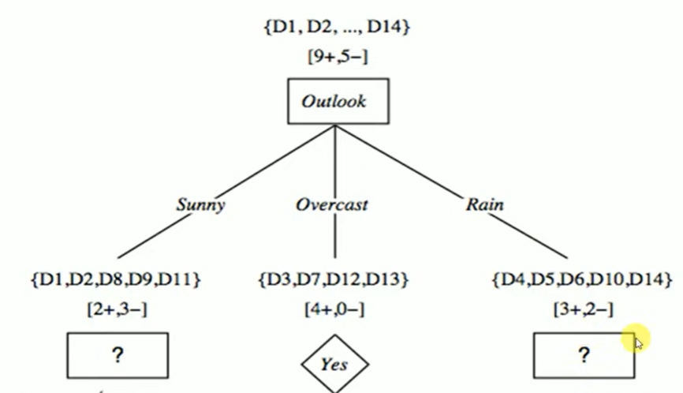

Slide 40
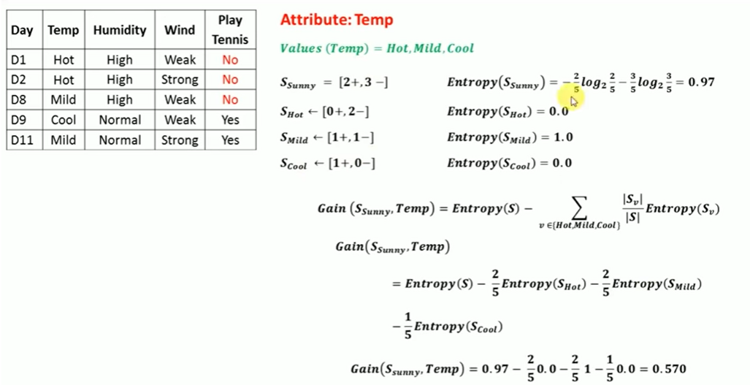

Slide 41
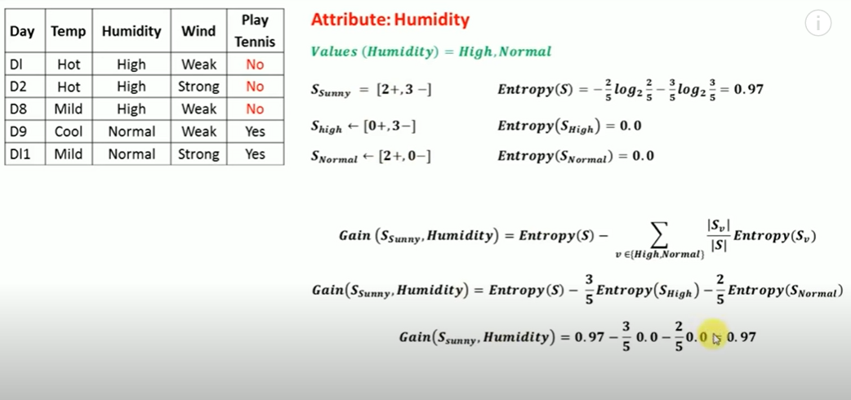

Slide 42
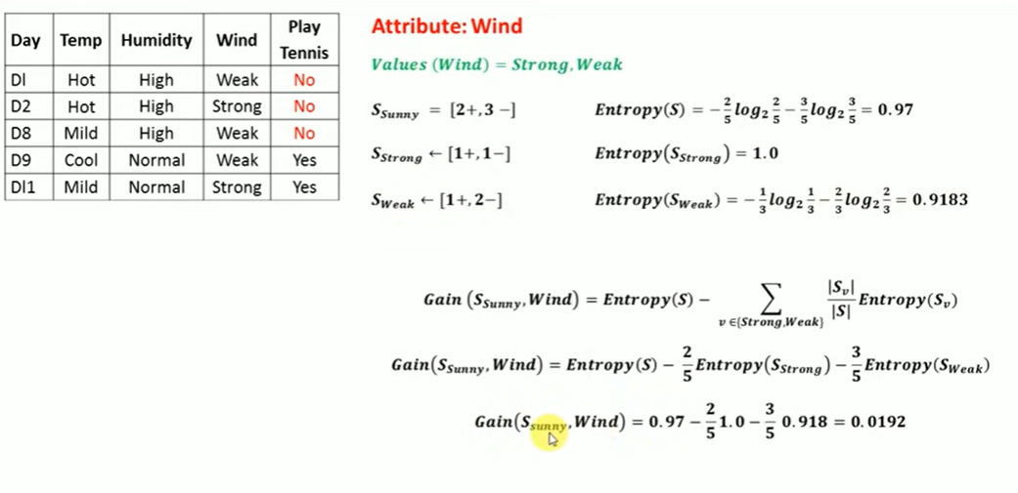

Slide 43
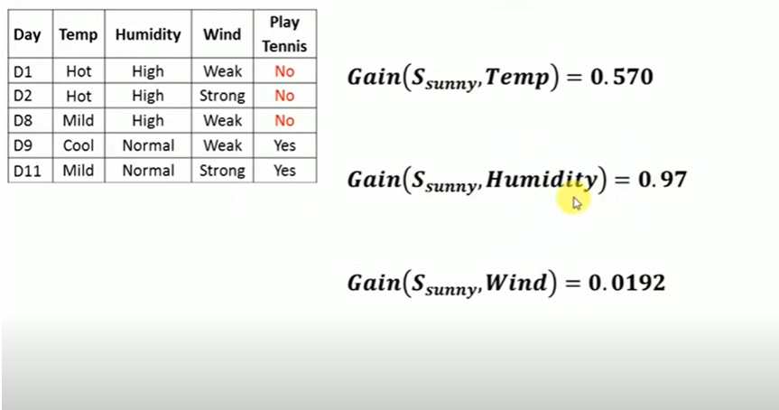

Slide 44
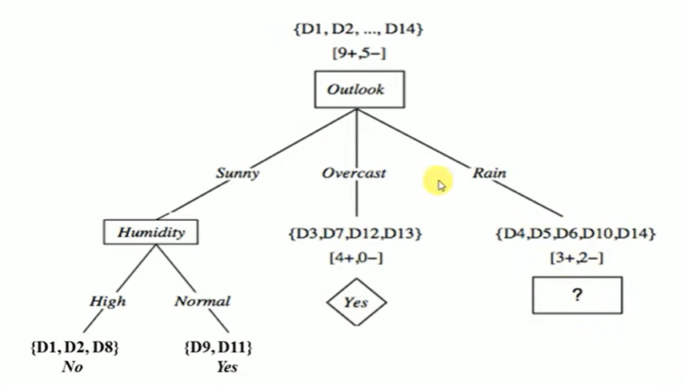

Slide 45
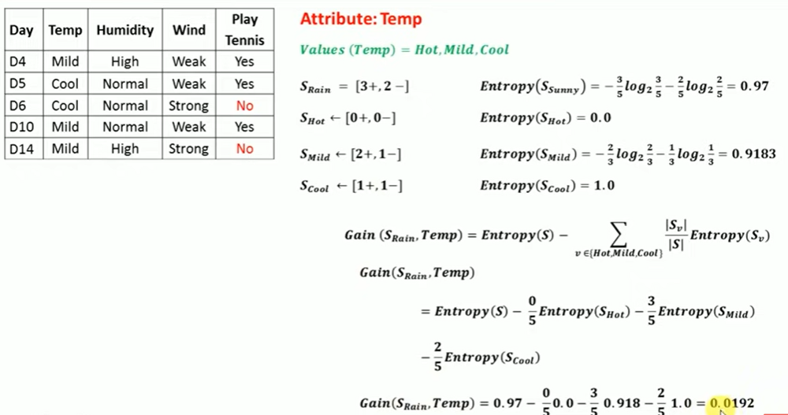

Slide 46
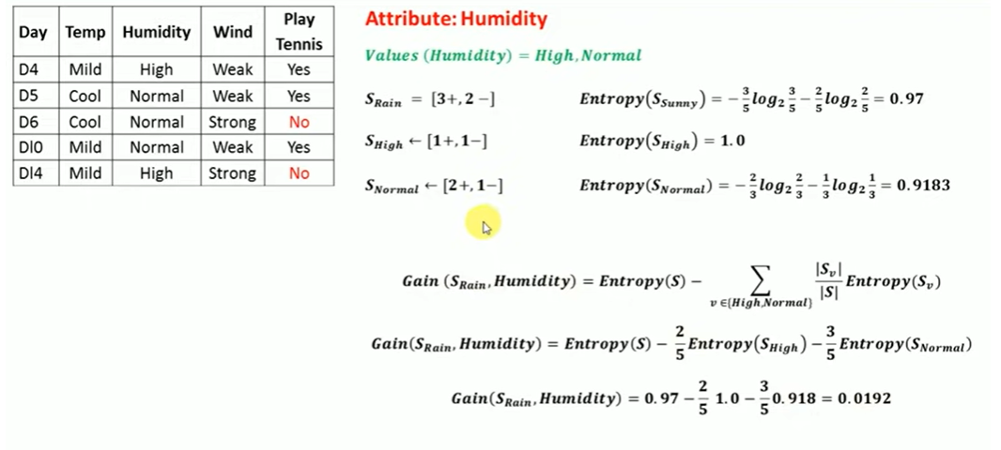

Slide 47
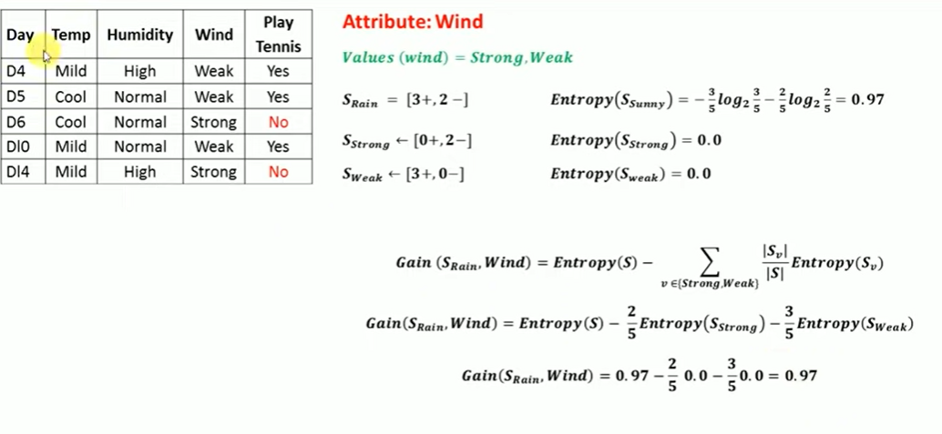

Slide 48
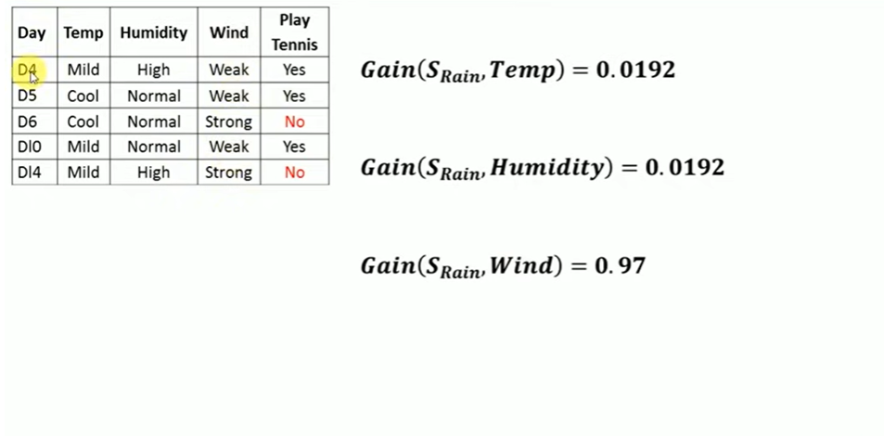

Slide 49
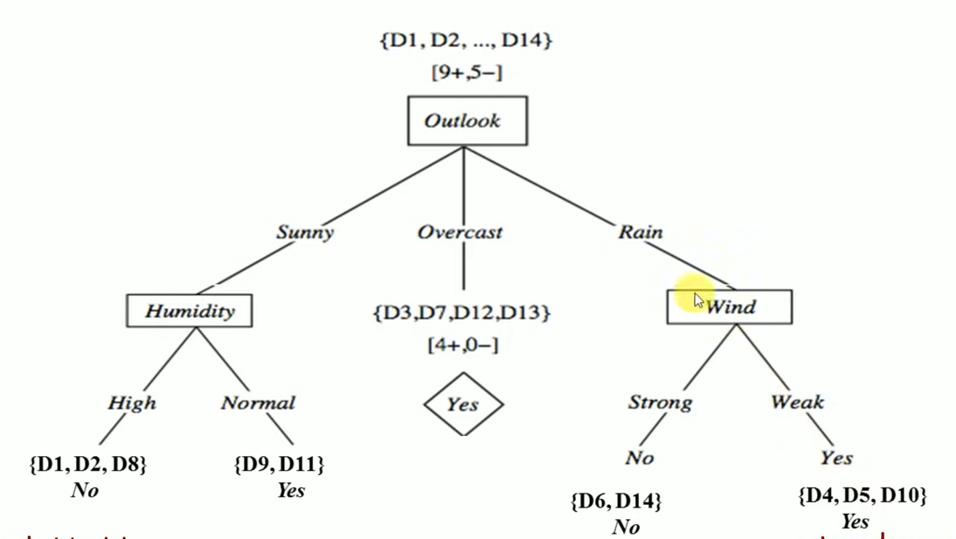

Slide 50
Strengths of decision tree
It produces very simple understandable rules. For smaller trees, not much mathematical and computational knowledge is required to understand this model.
Works well for most of the problems.
It can handle both numerical and categorical variables.
Can work well both with small and large training data sets.
Decision trees provide a definite clue of which features are more useful for classification.

Slide 51
Weaknesses of decision tree
Decision tree models are often biased towards features having more number of possible values, i.e. levels.
This model gets overfitted or underfitted quite easily.
Decision trees are prone to errors in classification problems with many classes and relatively small number of training examples.
A decision tree can be computationally expensive to train.
Large trees are complex to understand.

Slide 52
Logistic Regression
Logistic Regression is a Machine Learning classification algorithm that is used to predict the probability of a categorical dependent variable.
In logistic regression, the dependent variable is a binary variable that contains data coded as 1 (yes, success, etc.) or 0 (no, failure, etc.).
In other words, the logistic regression model predicts P(Y=1) as a function of X.
In the logistic regression model, a chi-square test is used to measure how well the logistic regression model fits the data.
The goal of logistic regression is to predict the likelihood that Y is equal to 1 given certain values of X.

Slide 53
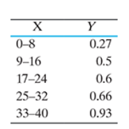
Logistic Regression
For example, we might try to predict whether or not a small project will succeed or fail on the basis of the number of years of experience of the project manager handling the project.
To illustrate this, it is convenient to segregate years of experience into categories (i.e. 0–8, 9–16, 17–24, 25–32, 33–40). If we compute the mean score on Y (averaging the 0s and 1s) for each category of years of experience, we will get something like

Slide 54
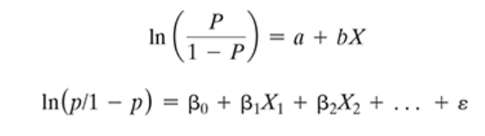
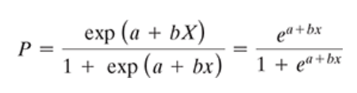
Logistic Regression
An explanation of logistic regression begins with an explanation of the logistic function, which always takes values between zero and one. The logistic formulae are stated in terms of the probability that Y = 1, which is referred to as P. The probability that Y is 0 is 1 − P.
Probability (P) can also be computed from the regression equation. So, if we know the regression equation, we could, theoretically, calculate the expected probability that Y = 1 for a given value of X.

Slide 55
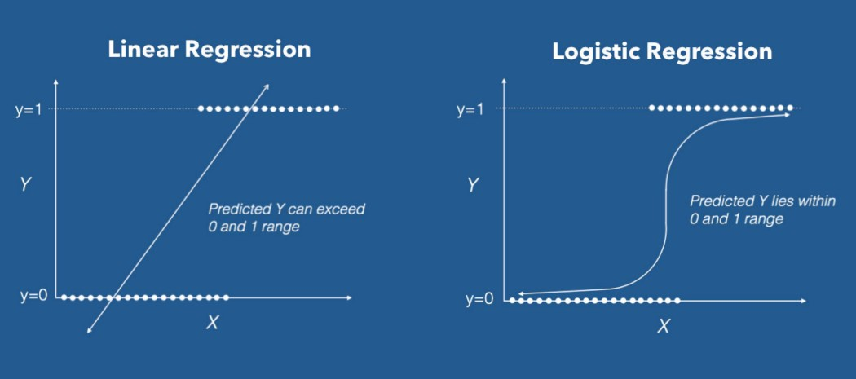

Slide 56
Let us say we have a model that can predict whether a person is male or female on the basis of their height. Given a height of 150 cm, we need to predict whether the person is male or female.

Slide 57
Naïve Bayes Classifier
Naïve Bayes is a probabilistic machine learning algorithm based on the Bayes Theorem, used in a wide variety of classification tasks.
It is a classification technique based on Bayes’ Theorem with an independence assumption among predictors. In simple terms, a Naive Bayes classifier assumes that the presence of a particular feature in a class is unrelated to the presence of any other feature.
The Naive Bayes classifier works on the principle of conditional probability, as given by the Bayes theorem.

Slide 58
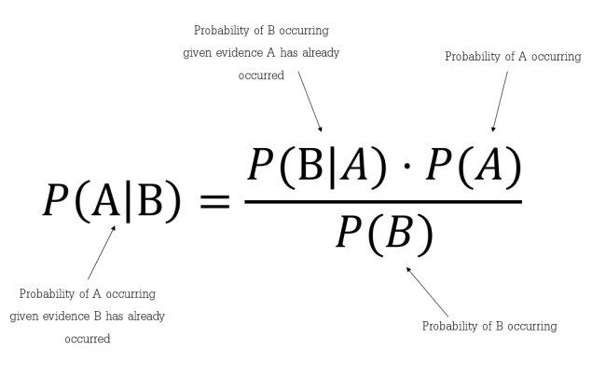
Naïve Bayes Classifier
Bayes’ Theorem is a simple mathematical formula used for calculating conditional probabilities.
Conditional probability is a measure of the probability of an event occurring given that another event has occurred.
The formula is: —
Which tells us: how often A happens given that B happens, written P(A|B) also called posterior probability, When we know: how often B happens given that A happens, written P(B|A) and how likely A is on its own, written P(A) and how likely B is on its own, written P(B).

Slide 59
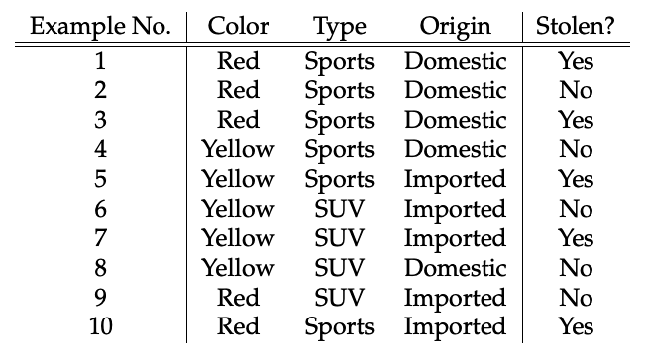
Here in our dataset, we need to classify whether the car is stolen, given the features of the car.

Slide 60
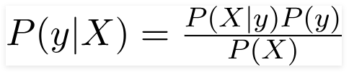
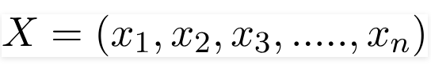
According to this example, Bayes theorem can be rewritten as:
The variable y is the class variable(stolen?), which represents if the car is stolen or not given the conditions. Variable X represents the parameters/features.
X is given as,
Here x₁, x₂…, x_{n} represent the features, i.e they can be mapped to Color, Type, and Origin.

Slide 61


By substituting for X and expanding using the chain rule we get,
For all entries in the dataset, the denominator does not change, it remains static. Therefore, the denominator can be removed and proportionality can be injected.

Slide 62

In our case, the class variable(y) has only two outcomes, yes or no. There could be cases where the classification could be multivariate. Therefore, we have to find the class variable(y) with maximum probability.
Using the above function, we can obtain the class, given the predictors / features.

Slide 63
Step 1: First construct a frequency table. A frequency table is drawn for each attribute against the target outcome
Step 2: Create Likelihood table by finding the probabilities
Step 3: Now, use Naive Bayesian equation to calculate the posterior probability for each class. The class with the highest posterior probability is the outcome of the prediction.

Slide 64

Step1&2
Frequency and Likelihood tables of ‘Color’

Slide 65

Step1&2
Frequency and Likelihood tables of ‘Type’

Slide 66

Step1&2
Frequency and Likelihood tables of ‘Origin’

Slide 67


As per the equations discussed above, we can calculate the posterior probability P(Yes | X) as :

Slide 68

P( No | X ):
Since 0.144 > 0.048, Which means given the features RED SUV and Domestic, our example gets classified as ’NO’ the car is not stolen.

Slide 69
Applications of Naive Bayes Algorithms
Real-time Prediction
Multi-class Prediction
Text classification/ Spam Filtering/ Sentiment Analysis
Recommendation System

Slide 70
Support Vector Machine (SVM)
A Support Vector Machine (SVM) is a supervised machine learning algorithm that can be employed for both classification and regression purposes.
SVMs are more commonly used in classification problems
It uses the non linear mapping to transform the original training data into higher dimension
SVM is based on the concept of a surface, called a hyperplane, which draws a boundary between data instances plotted in the multi-dimensional feature space.
the SVM algorithm builds an N-dimensional hyperplane model that assigns future instances into one of the two possible output classes.

Slide 71
Support Vector Machine (SVM)
In SVM, a model is built to discriminate the data instances belonging to different classes.
Let us assume for the sake of simplicity that the data instances are linearly separable. In this case, when mapped in a two dimensional space
The data instances belonging to different classes fall in different sides of a straight line drawn in the two-dimensional space as depicted in Figure 7.15a.
If the same concept is extended to a multidimensional feature space, the straight line dividing data instances belonging to different classes transforms to a hyperplane as depicted in Figure 7.15b.

Slide 72


Slide 73
Support Vector Machine (SVM)
An SVM model is a representation of the input instances as points in the feature space, which are mapped so that an apparent gap between them divides the instances of the separate classes.
In other words, the goal of the SVM analysis is to find a plane, or rather a hyperplane, which separates the instances on the basis of their classes.
New examples (i.e. new instances) are then mapped into that same space and predicted to belong to a class on the basis of which side of the gap the new instance will fall on.
In summary, in the overall training process, the SVM algorithm analyses input data and identifies a surface in the multi-dimensional feature space called the hyperplane

Slide 74
Support Vector Machine (SVM)
Hyperplane:
In a p-dimensional space, a hyperplane is a flat affine subspace of dimension p − 1.
In two dimensions, a hyperplane is a flat one-dimensional subspace - in other words, a line.
In three dimensions, a hyperplane is a flat two-dimensional subspace - that is, a plane
In p > 3 dimensions, it can be hard to visualize a hyperplane, but the notion of a (p − 1)-dimensional flat subspace still applies

Slide 75



Hyperplane:

Slide 76




Hyperplane:
A Point
Is on Hyperplane if
Is on one side of hyperplane if
Is on other side of hyperplane if

Slide 77


Classification using Hyperplane
n×p data matrix X
X | 1 | 2 | … | p
1
2
…
n
n training observations in p-dimensional
These observations fall into two classes
y1, . . . , yn ∈{−1, 1} where −1 represents one class and 1 the other class.
test observation
Our goal is to develop a classifier based on the training data that will correctly classify the test observation using its feature measurements.

Slide 78

Support Vector Machine (SVM)
The operation of the SVM algorithm is based on finding the hyperplane that gives the largest minimum distance to the training examples.
what if the data points are not linearly seperable? In that case how do we find the optimal hyperplane.

Slide 79


Classification using Hyperplane
A new approach based on Separating Hyperplane
Various approaches like Logistic Regression, etc.
Separating Hyperplane
If f(x*) is +ve, class = 1
If f(x*) is -ve, class = -1
If f(x*) is far from 0, confident on class.
If f(x*) is near to 0, less confident on class.
3 hyperplanes on classes x1 and x2 data
A classifier that is based on a separating hyperplane leads to a linear decision boundary.

Slide 80


Maximal Margin Classifier
Maximal margin hyperplane also known as the optimal separating hyperplane
It is the separating hyperplane that is farthest from the training observations.
Compute the (perpendicular) distance from each training observation to a given separating hyperplane
The smallest distance is the minimal distance from the hyperplane, and is known as the margin
Find Minimal distance for all hyperplanes.
The maximal margin hyperplane is the separating hyperplane for which the margin is largest
classify a test observation based on which side of the maximal margin hyperplane it lies.
This is known as the maximal margin classifier.

Slide 81



Support Vector Classifier
Observations of classes are not be separable by a hyperplane.
Even if a separating hyperplane does exist, some instances in which a classifier might not be desirable.
A classifier based on a separating hyperplane will necessarily perfectly classify all of the training observations
Tiny Margin

Slide 82
Support Vector Machine (SVM)
Support Vectors: Support vectors are the data points (representing classes), the critical component in a data set, which are near the identified set of lines (hyperplane). If support vectors are removed, they will alter the position of the dividing hyperplane.
Hyperplane and Margin: For an N-dimensional feature space, hyperplane is a flat subspace of dimension (N−1) that separates and classifies a set of data. For example, if we consider a two-dimensional feature space (which is nothing but a data set having two features and a class variable), a hyperplane will be a one-dimensional subspace or a straight line. In the same way, for a threedimensional feature space (data set having three features and a class variable), hyperplane is a two-dimensional subspace or a simple plane.

